Slide 1
Why, How & What Now: Assisting International Students Struggling Academically
February 3, 2017
Caroline Omolesky
Program Officer for Sponsored Programs & Academic Liaison, Office of International Affairs

Slide 2
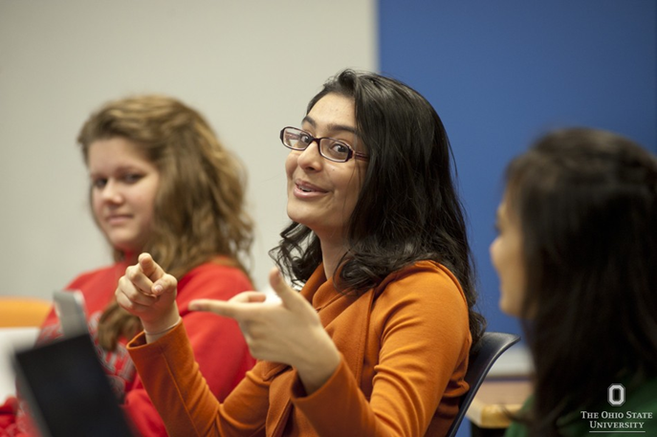
Office of International Affairs:
International Students & Scholars
How do we define “international student”? anyway?

Slide 3
Who is considered an “international student”?
For OIA’s purposes, this just refers to students who are in F-1 or J-1 non-immigrant status—i.e., students whose immigration status in the US is dependent on their status as full time students at Ohio State.

Slide 4
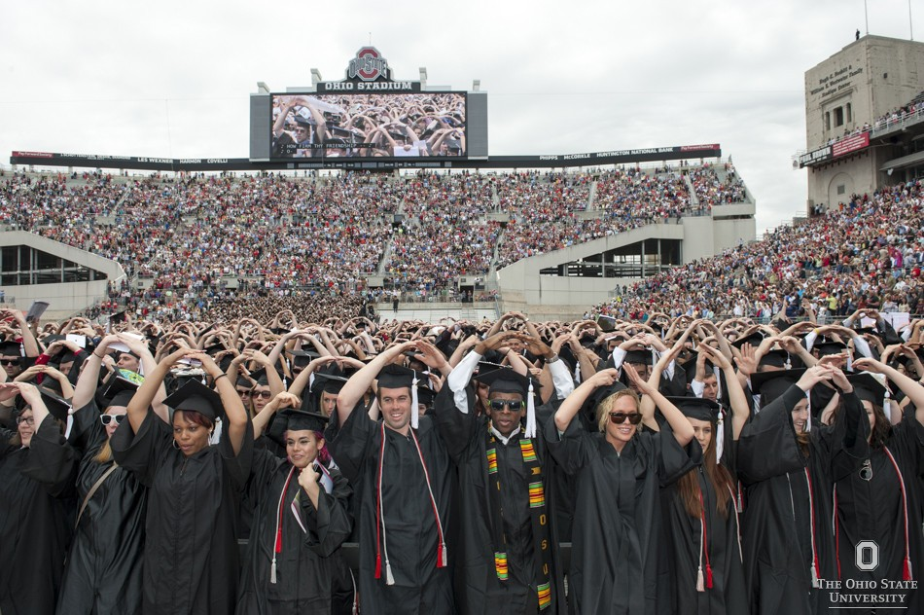
Office of International Affairs:
International Students & Scholars
What about numbers?
Image: Ohio State University Communications photo gallery

Slide 5
At Ohio State:
There are currently (as of September 13, 2016) 6,446 international students studying at Ohio State in F-1 or J-1 status.
Of those, 3,659 are undergraduates.
International students make up roughly 10% of Ohio State’s student body.
Ohio State Enrollment Services: http://oesar.osu.edu/student_enrollment.aspx

Slide 6
Office of International Affairs:
International Students & Scholars
Where do international students come from?

Slide 7
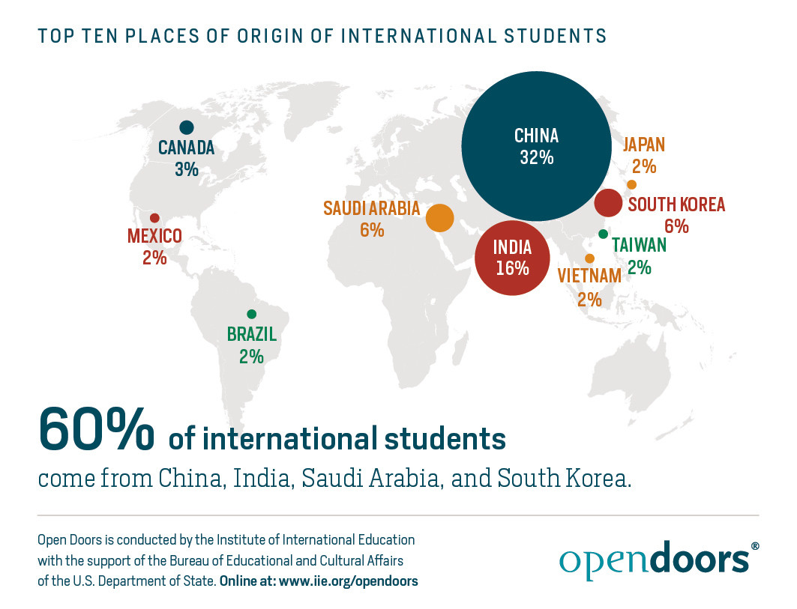
Office of International Affairs:
International Students & Scholars
In the United States:
Image: Institute of International Education, www.iie.org/opendoors

Slide 8
At Ohio State:
Top seven countries of origin, with Autumn 2016 enrollment numbers at all levels:
1) China: 4,024
(UG: 2,741; Gr: 1,254; Prof: 29)
2) India: 591
(UG: 121; Gr: 465; Prof: 5)
3) South Korea: 370
4) Malaysia: 266
5) Taiwan: 122
6) Indonesia: 73
7) Canada: 69
Ohio State Enrollment Services: http://oesar.osu.edu/student_enrollment.aspx

Slide 9
Office of International Affairs:
International Students & Scholars
Immigration Requirements

Slide 10
To maintain legal status in the U.S., all international students must:
Enroll full time every semester
Only work up to 20 hours per week or less on campus
Not work off campus without authorization
Keep address up to date in Buckeyelink
Keep all immigration documents up to date
Passport
I-20 or DS-2019
(Not necessarily the visa!)
Ohio State Enrollment Services: http://oesar.osu.edu/student_enrollment.aspx

Slide 11
Office of International Affairs:
International Students & Scholars
Academics:
- Strengths
- Struggles
- Resources

Slide 12
Needs Assessment Survey
In December ’13 – January ’14, OIA surveyed international undergraduates about their academic experiences
Students assessed their own English proficiency, and were asked about their academic challenges
The results were used to develop new academic workshops for international students

Slide 13
Needs Assessment Survey
Key Findings:
Students with lower self-rated English proficiency experience higher levels of academic difficulties.
Students rated interacting with, and building relationships with, American classmates as the most difficult academic task.
Students transferring from a school in their home country report a significantly higher degree of difficulty with common academic tasks.

Slide 14
Needs Assessment Survey
Tasks international students reported finding most difficult, in order of perceived difficulty:
Building relationships with American classmates
Interacting with American classmates
Building relationships with professors/instructors
Working successfully in groups with American classmates
Asking questions in class
Speaking generally in class
→ All of these skills involve oral communication, and also require strong cultural competency.

Slide 15
Office of International Affairs:
International Students & Scholars
First Year Transition
Image: Ohio State University Library, by Vasenka Photography

Slide 16
The First Year Transition
If you’re a first year international student, what will you notice as being different studying in your home country?
Little to no “hand holding”
Expectation to speak in class/have small group discussions
Expectation to share original ideas
Expectation to attend class regularly
Expectation not to copy and paste text from other sources
Expectation to complete homework alone/not with friends
Types of and frequency of assignments
English!

Slide 17
The First Year Transition
Other sources of surprise for first year international students:
Less feeling of community among students in the same major
Taking classes outside their major
Such a wide variety of courses to choose from
No access to the syllabus prior to registering for a course
Non-STEM fields are taken seriously
Everything about Carmen/Canvas
Experiencing failure for the first time
For Asian students, being identified as “Asian” rather than by nationality
Housing arrangements

Slide 18
The First Year Transition
So basically, everything feels different.
Students who adapt less easily will quickly feel overwhelmed.

Slide 19
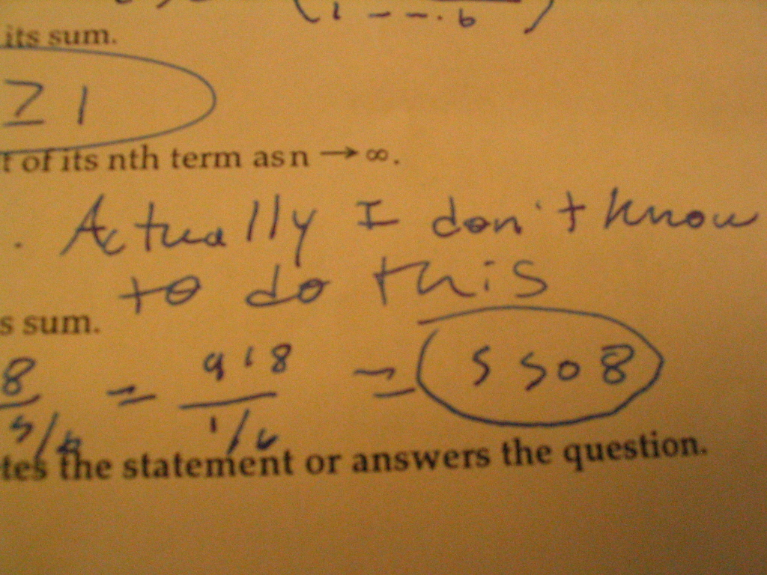
Office of International Affairs:
International Students & Scholars
Academic Struggles
Image: Math Class, by Lauren (flickr username)

Slide 20
Academic Struggles
International students struggle for many of the same reasons American students do:
family issues (death in family, divorce of parents, etc.)
relationship issues (break-ups, domestic violence, abortion)
mental or physical health problems
poor lifestyle choices
poor time management
overwhelmed in the first semester by the pace of classes
challenging math classes (or other subjects, but math is the most common subject for students to fail)
These are compounded by being far from home.

Slide 21
Academic Struggles
International students are more likely than their American peers to struggle with:
understanding professors in class & keeping up with the pace of lectures
class participation
misunderstandings about assignments (what is expected, due dates, major vs. minor assignments, etc.)
adapting to a new academic environment and way of learning
There is often a cultural stigma against seeking professional help, especially with personal problems.

Slide 22
Academic Struggles
Mental health problems:
A student not attending or failing all their courses is probably an unhealthy student
A student who appears “lazy” might actually be very depressed (cannot muster the motivation)
Don’t hesitate to refer to CCS!
link the referral to academic success
If you sense a student is depressed they probably need help, but may not know how to get it
a five minute conversation can change a life
Consider attending suicide prevention training (REACH)
Instructors see students on a more regular basis than anyone else at the university
Your role is not to make a student well, just to direct them to help

Slide 23
Academic Struggles
I e-mail all international students at the time they are placed on probation, with information about academic resources on campus, and explaining options in the case of dismissal.
I request that all students on probation meet with me to discuss their progress, and their sources of difficulty.

Slide 24
Academic Struggles
Quotes from undergraduate international students during probation appointments:
“Back in China I wasn't the kind of student who would have to seek help.”
“I am not going to talk to anyone about my family problems.”
“The way of learning here is totally different from in my home country.
“I think I am the only one having this issue.”
“I’ve had trouble regulating my life in the US.”
“I have a hard time understanding my instructors.”
“I registered for an on-line course I didn’t know was on-line.”
“But everything is going really well this semester!”

Slide 25
Academic Struggles
If, in the worst case scenario, an international student is academically dismissed from the university, OIA must either:
terminate the SEVIS record
transfer the SEVIS record to another school
Federal regulations dictate that we must take action on a student’s record within 21 days of the dismissal, or by the start of the next term, whichever is sooner.
If the record is terminated, the student must depart from the US immediately (no grace period).

Slide 26
Academic Probation & Dismissal: Statistics for Autumn ’16
University Probation for F and J undergraduates:
Total: 79
51 (65%) were in their first year
To date, 30 have completed their appointment with me
6 of the total have a 0.0 GPA, having failed all courses they have ever taken at the university
Academic Dismissals for F and J undergraduates:
Total: 20
3 were in their first year
9 transferred out to Columbus State
most intend to apply to be reinstated in the future

Slide 27
Office of International Affairs:
International Students & Scholars
Academic Integrity
Image: Cookbook, by Scott Akerman

Slide 28
Academic Integrity
International students are over-represented in COAM (Committee on Academic Misconduct) cases.
Many cases are the result of a misunderstanding about an instructor’s expectations, and some are examples of outright cheating. In both cases, students almost always tell me, “if I had done this in my home country, it wouldn’t have been a big deal.”
Rules surrounding the use of other people’s words and ideas are radically different in other countries.
OIA presents on academic integrity at Orientation, but that alone is not enough to prepare students for our academic standards.

Slide 29
Academic Integrity
Quotes from undergraduate international students during academic misconduct appointments:
“I was only copying from the textbook. How can that be plagiarism?”
“I thought my professor wanted us to give the correct answer—that’s why I copied it from the reading.”
“I know they always take the professor’s side at COAM. They’ll never listen to me because I’m an international student.”
“Now I can’t concentrate on my other courses, and I’m not sleeping.”
“Will this show on my transcript? Will it affect my graduate school applications?”
“Can you explain probation again? I don’t understand.”

Slide 30
Office of International Affairs:
International Students & Scholars
Academic Support
Image: Pile of books, by Raoul Luoar

Slide 31
Academic Support
OIA’s Academic Success Series workshops:
Preparing Effective Papers
Preparing for Writing at the University
Developing Effective Study Skills: Memory Tools and Reading Strategies
Communicating with Faculty & Instructors
Academic Success 101
Building Confidence in Participating in Discussions and Preparing a Class Presentation
Foundations of Writing for the Classroom
Keys to Strategic, Confident Test Taking
http://oia.osu.edu/workshops-and-events/workshops.html

Slide 32
Academic Support
Additionally, we refer students to:
Their professors and instructors
Their academic advisors
Dennis Learning Center
Writing Center
On-campus tutoring
Non-academically-focused support services
Counseling & Consultation Service
Wellness Center
Student Advocacy

Slide 33
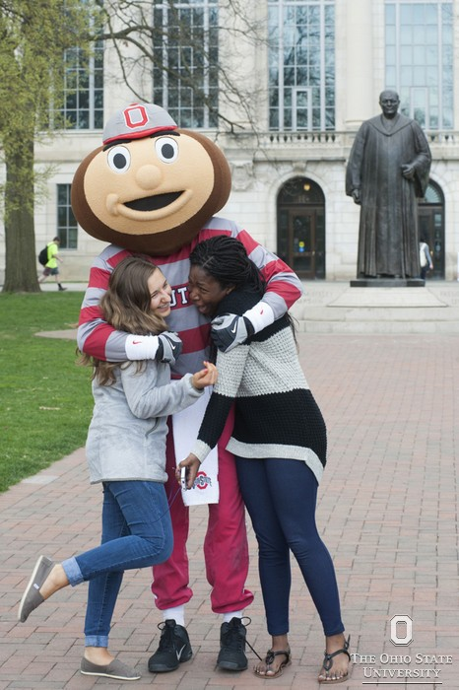
Office of International Affairs:
International Students & Scholars
Community Building
Image: brutus_stu_0800, Ohio State University Communications photo gallery

Slide 34
What can you do?
How do we ensure Ohio State’s international students feel welcome and included?
Be patient and friendly
Show interest in students’ home country and culture, but. . .
See students as individuals, not representatives of their home country
Provide positive feedback on students’ English language skills– students need confidence boosters
Help students navigate Ohio State’s bureaucracy
- explain processes in plain language
- don’t assume knowledge
Refer students to OIA’s Global Engagement programs

Slide 35
Office of International Affairs:
International Students & Scholars
Thank you!
Questions?
Image: question mark, by Karen Eliot

