Slide 1
Play→Fun→Learn:
Using gaming and interactive activities
to help students learn
Pam Schopieray and Sue Scheutzow

Slide 2
ESCE 2271
SELF-CAREER DEVELOPMENT
Spring 2017
SMART Learning Cohorts:
Buckeye Scholars of Color
New Generation Scholars
Notes:
We are teaching a 2 credit class with 28 students from the SMART cohorts. Last semester, these two cohorts were in at least two classes together—EXP, which was combined with a seminar course & another GE class. As a result, the students in each cohort had the opportunity to develop relationships with each other and the instructors: Academic Advisor & the Coordinator of Diversity & Inclusion. For this semester, most of the students in the two cohorts are in our class—some of them couldn’t take it as the result of a scheduling conflict. When the planning began for these cohorts, the goal was to have all of them take the career class. The planning committee wanted them to have a semester long self & career development class so that they would have the experience of learning more about career exploration, career goal setting, professionalism and career readiness for the world of work.

Slide 3
Reasons why we had to get creative:
Visual learners
Tech savvy
Experimenters
Collaborators
Flexible
Gen
Notes:
Researchers dub Generation Z, born 1995 to 2009, as being the most tech-savvy generation. They desire more out-of-the- box and progressive methods of learning other than the traditional taking notes while the professor lectures. That point is not lost on marketers. In an era of emoji and six-second Vine videos, “we tell our advertising partners that if they don’t communicate in five words and a big picture, they will not reach this generation,” said Dan Schawbel, the managing partner of Millennial Branding, a New York consultancy.
Researchers like OSU’s Dr. Sue Sutherland, College of Education and Human Ecology, research in “active learning” support the need to integrate gaming and interactive activities that involve reflection into the classroom to help students learn. There are a variety—over 30—different types of active learning. Today, we will focus upon gaming, icebreakers, and collaborative learning small groups.

Slide 4
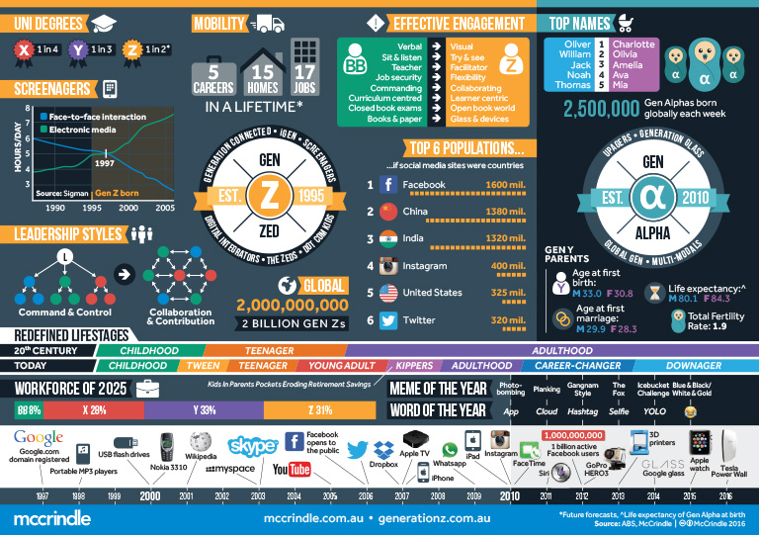
GEN Z Infographic
Notes:
One infographic by mccrindle.com.au shows that students born in 2005: Electronic Media—71/2 hours a day vs. Face to Face 1.5 hours or less a day--Screenagers; Engagement Preferences: Visual, Try & See, Collaborating…(mccrindle is a research marketing company that identifies trends (Forecasts) to advice organizations of Strategy. As we prepared for the class this term, we considered how we could change up our assignments to make them more interactive so that the students could “try it and see it” and collaborate in small groups. Flexibility has come into play as we discovered that several of the students in class had issues with printing—i.e. WiFi issues at off campus apartments.

Slide 5
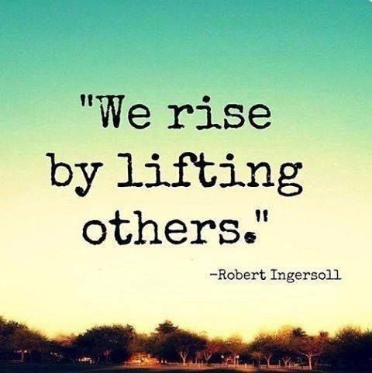
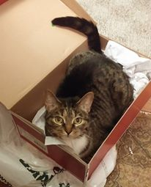
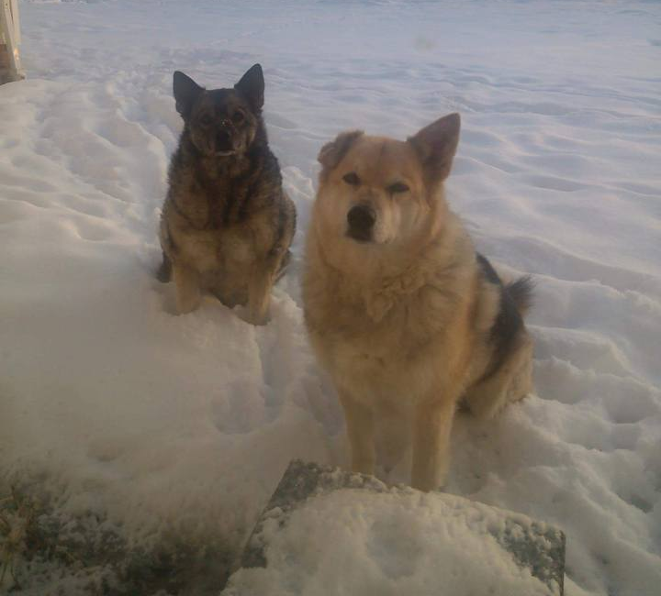
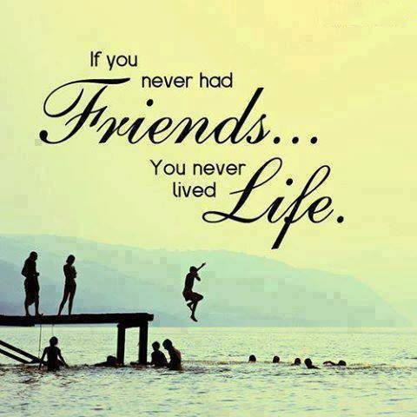
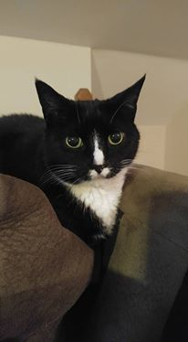
Ice Breaker: 10 Images

Slide 6
University Exploration Survey Class
Our humble beginnings in gaming…
Notes:
Researchers dub Generation Z, born 1995 to 2009, as being the most tech-savvy generation. They desire more out-of-the- box and progressive methods of learning other than the traditional taking notes while the professor lectures. That point is not lost on marketers. In an era of emoji and six-second Vine videos, “we tell our advertising partners that if they don’t communicate in five words and a big picture, they will not reach this generation,” said Dan Schawbel, the managing partner of Millennial Branding, a New York consultancy.
Researchers like OSU’s Dr. Sue Sutherland, College of Education and Human Ecology, research in “active learning” support the need to integrate gaming and interactive activities that involve reflection into the classroom to help students learn. There are a variety—over 30—different types of active learning. Today, we will focus upon gaming, icebreakers, and collaborative learning small groups.

Slide 7
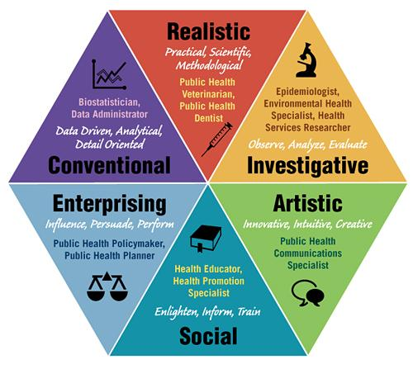
Holland’s Theory
Notes:
Our first attempt at using gaming was in 14 sections of EXP last fall. We were looking for a more interactive method to teach students about Holland’s theory of personality types and how it can be used to help find occupational options. We gave the students a brief introduction, had them take a checklist of personality characteristics to determine their Holland Code, then gave them some examples. After, we had them play a game we created in Kahoot.

Slide 8
Let’s
Play!
Notes:
Let’s play Kahoot! How many instructors do you know that use gaming to introduce the topics of their courses? We did. Sue created a Kahoot using common career myths to introduce the syllabus. After the success of using Kahoot in EXP classes, we decided to try it with our Self & Career class this semester. We introduced the topics in the syllabus using common career myths via Kahoot. The students liked it so much, they asked to play again. We think that some liked the competition; some liked the idea of getting a reward--$10.00 Visa Gift Card.

Slide 9
StrengthsFinder
Notes:
As part of their self assessment, we had the students take Gallup’s StrengthsFinder. How many of you are familiar with it? If you are not, it is an assessment developed from positive psychology. The Clifton StrengthsFinder® is the culmination of more than 50 years of Dr. Donald O. Clifton's lifelong work, which has led to more than 10 million people worldwide discovering their strengths. In 2002, Dr. Clifton was honored by an American Psychological Association Presidential Commendation as the Father of Strengths-Based Psychology.
The Clifton StrengthsFinder is a powerful online assessment that helps individuals identify, understand, and maximize their strengths. The accompanying book, StrengthsFinder 2.0, is a Wall Street Journal, BusinessWeek, and USA Today bestseller. Since debuting in 2007, the book was named Amazon's bestselling book of 2013.
All people have a unique combination of talents, knowledge, and skills -- strengths -- that they use in their daily lives to do their work, achieve their goals, and interact with others. Gallup has found that when people understand and apply their strengths, the effect on their lives and work is transformational. People who use their strengths every day are six times more likely to be engaged in their work and three times more likely to say they have an excellent quality of life.
Yet, many people don't know what their strengths are or have the opportunity to use them to their advantage. In fact, many people tend to focus on fixing their weaknesses. By exploring the ways in which you naturally think, feel, and behave, Clifton StrengthsFinder can identify and build on the areas where you have infinite potential to grow and succeed.
Reference: http://www.gallup.com/products/170957/clifton-strengthsfinder.aspx First they reviewed their signature theme reports and answered 5 reflection questions.
Put them into pairs and then into fours to review their Activity 1.3 worksheet. Have each one select one of their top five to share with the class. (We will have a list and check them off to try to avoid too many picking the same ones.) Ask them to pick a reporter and a recorder. Give them a sheet of poster paper to write out their strengths with brief definitions. (4 strengths per sheet) Reporter(s) shares with the class.
In addition, we are helping them learn about all 34 by using Gallup’s Insight Cards. For this activity, we put them in pairs, had them choose two cards, then answer a couple of questions about what it would be like to work with a co-worker that had those two Strengths in their top five. In front of you, you have two insight cards and a handout. Please work in pairs to answer the questions. After, we will ask you to report out your results so that we can learn more about the two strengths that you have versus reading definitions from the website.

Slide 10
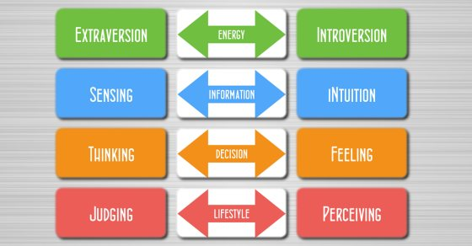
MBTI Activity
Notes:
As part of their self assessment, we had them take the MBTI. Ask: How many are familiar with the MBTI? For those of you that are not it is a personality assessment designed to help you sort out your preferred ways of taking in information, processing it, and making decisions. We see it as a way to understand how you communicate and how others communication differently from you. To help the students process their results, we had them participate in an activity that got them out of their seats. We had posters of each dichotomy. Students selected the preference that was most like them. We gave them a handout with highlights of each preference. Then had them reflect upon what the opposite preference of their type could contribute to a work team. Sue and I share our examples of decision making—her as the T and me as the F. After we had them apply their MBTI to their career path by using www.personalitypage.com and answering some questions about 2 occupations using the Occupational Outlook Handbook and/or ONET.org.

Slide 11
Questions

Slide 12
Presenters
Pam Schopieray
Director of Career Development
Schopieray.4@osu.edu
Sue Scheutzow
Career Development Intern
Scheutzow.5@osu.edu

Slide 14
References
Martin, Lauren. "How Generation Z Learns." Learning Liftoff. K12 Inc., 25 Mar. 2016. Web. 02 Feb. 2017.
http://www.learningliftoff.com/generation-z-learns/#.WFBRUXpuMeQ.
Lang, James M. Small Teaching: Everyday Lessons from the Science of Learning. San Francisco, CA: Jossey-Bass, 2016. Print.
"What's Hot Right Now." Understanding Generation Z Learning Styles in Order to Deliver Quality Learning Experiences. Precision Industries, 29 July 2015. Web. 02 Feb. 2017.
http://www.precisionindustries.com.au/whats-hot-right-now-blog/understanding-generation-z-learning-styles-in-order-to-deliver-quality-learning-experiences
McCrindle. "The McCrindle Blog." Gen Z and Gen Alpha Infographic Update. McCrindle Pty Ltd, 4 Feb. 2015. Web. 02 Feb. 2017.Gen Z Infographic
http://mccrindle.com.au/

