Slide 1
Peer mentoring models and best practices in academic settings
#FYConference

Slide 2
Jeff Hattey
Professor and Assistant Dean,
College of Food, Agricultural
and Environmental Sciences
#FYConference

Slide 3
Student Success
The Ohio State University Goals
95% Retention Rate
60% 4-Year Graduation Rate
Program origin was to meet or exceed these goals with student population in the College of Food, Agricultural, and Environmental Sciences (CFAES)

Slide 4
Peer Mentor Programs
Peer mentoring programs are often designed to support
social connections
improve cognitive skills
where a majority of programing is protégé centric.

Slide 5
Peer Mentor Programs
This model has proven to be an effective means of enhancing
student growth
development
however, the value of and development of the peer mentor must not be overlooked.
Foundational to this program has been a focus on the development of the peer mentor.

Slide 6
Program Development
Established 2012 Academic Year
Mission: Support CFAES students and strengthen connections with the college and university communities.
Vision: Train students to serve as peer mentors who can assist new first year students (NFYS) integrate into the CFAES family.
The purpose of the CFAES Peer Mentoring program is to support the development and retention of students who are integrated in the campus community, strong academically, and capable leaders.
4 years
165 mentors
845 protégés
5:1 ratio

Slide 7
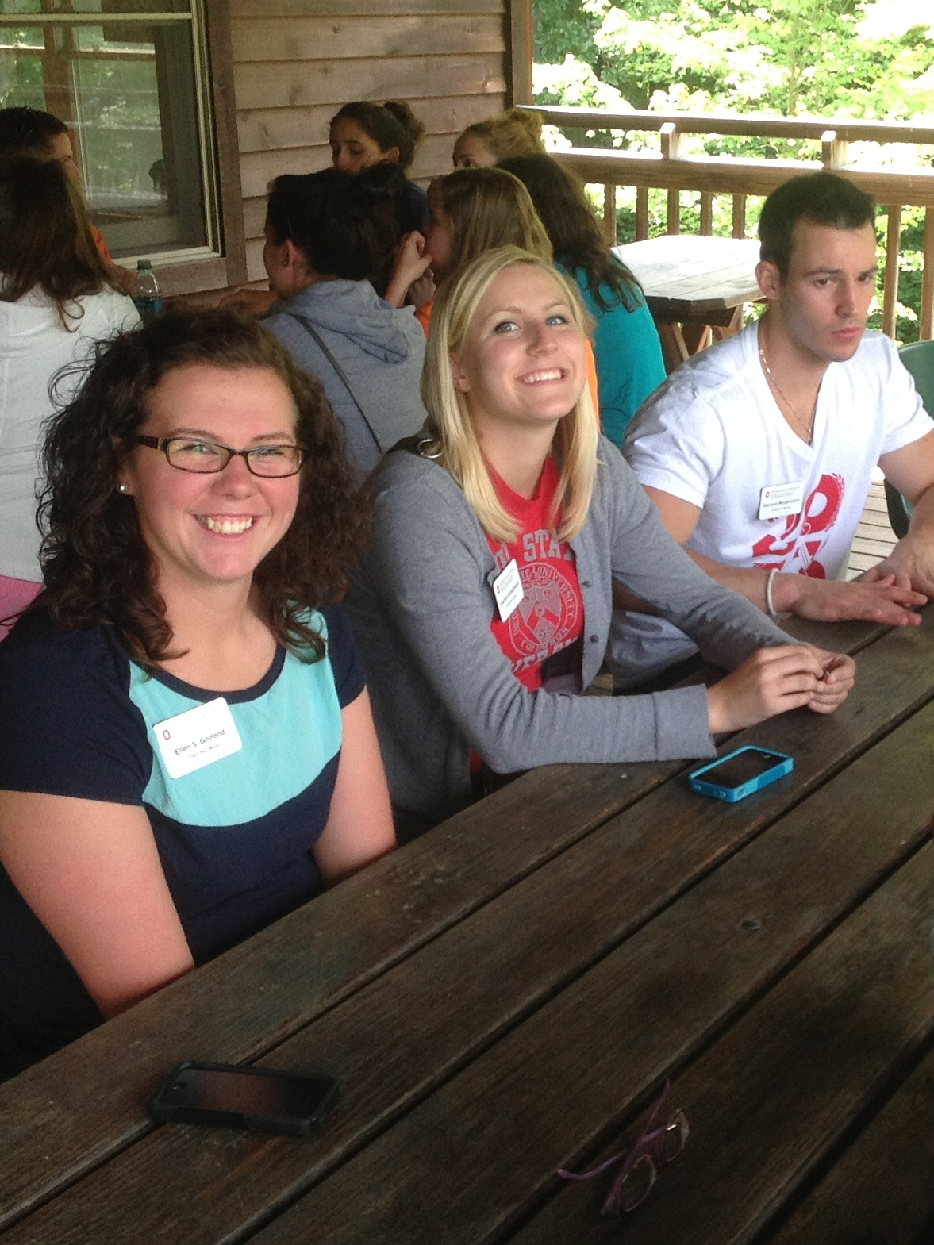
Mentor Selection
Competitive application and interview
process
Minimum Requirements:
Full time (12+ hours)
1+ term completed in CFAES
Good Academic Standing (GPA >2.5)
Demonstrated knowledge of college / university resources and opportunities
Involvement in student organizations
Commitment and availability for 1 year

Slide 8
Expectations
Participate in all training and planning activities throughout the academic year
Serve as an FAES 1100 undergraduate Teaching Assistant (TA) during Autumn Semester, facilitate small group interactions with protégés during recitation
Communicate with assigned group of NFYS by e-mail, text, phone call, or social media in a timely manner

Slide 9
Program Design
Winter/Spring
Mentor recruitment/selection
Summer
August
Training retreat
Spring Leadership Training
Assignment to student group
First mentor-protégé contact via email
Begin weekly recitation section meeting
Autumn
Weekly ongoing training
Weekly recitation section meetings (1st 7-weeks)
College-sponsored events
Winter/Spring
Biweekly leadership training
Career-development workshops
Personality Profile Instrument
FAES 1100
integration
Notes:
Peer Mentors work with an assigned group of freshmen in a college-wide, face-to-face freshmen orientation class (FAES 1100) over the course of a seven-week class session. After the conclusion of the formalized class, PMs maintain informal relationships with their mentees throughout their time in CFAES. In this group mentoring model, one peer mentor serves a group of freshman simultaneously in an approximately 1:5 ratio of mentors to mentees (Murray, 2015).
Food, Agricultural, and Environmental Sciences 1100 (FAES 1100) is a 0.5 credit hour, in person, seven-week, autumn semester, freshmen orientation class. The full class of approximately 200 students meets for a one-hour lecture once weekly, and students attend one of six hour-long recitations. Students are assigned to a recitation based on their selection of major, and recitations enroll approximately 20-50 students per section. It is during these recitation sections that the NFYS interact with their peer mentor. In addition, mentoring groups meet outside of regular class time for events, study groups, and social activities.

Slide 10
Benefits of a Peer Mentor Program
NFYS:
Meet fellow students in CFAES
Meet CFAES Faculty and Staff
Understand the value of a becoming an educated person
Explore academic freedom and integrity
Learn and understand the Land-Grant mission
Learn how and where to access resources important for success
Learn to navigate university policies and procedures
CFAES Peer Mentor
Strengthen invaluable personal, interpersonal, and leadership skills
Develop a professional relationship with CFAES Faculty and Staff
Gain teaching and mentoring experience
Add to your critical professional development skills for an enhanced resume
Inspire NFYS to strive for excellence and facilitate their integration into Ohio State and CFAES

Slide 11
Experiential Learning: Activities

Slide 12
Recitation Activities
Essential Resources for Student Success
Back 2 School Bash
CFAES Expedition
Essential Academic Policies & Procedures
A Day in the Life of a CFAES faculty member
Study Skills & Learning Strategies for Success
Degree Planning & Registration

Slide 13
Communication
Create opportunities to practice communication skills
Workshop training
Email mentee’s
Group preference
Communicate with faculty
Communicate with program staff

Slide 14
Decision Making and Problem Solving
Recitation Responsibilities
CFAES Expedition
Day in the Life
4 Year Plan
Logistics
Who
Where
How
Communication
Transportation

Slide 15
Self-Management
Given Responsibility In Class
Attend weekly meetings
Track attendance
Observe student actions

Slide 16
Teamwork
Students work together in recitation
Plan together
Cover for each other
Eat together

Slide 17
Professionalism
Mentors
Engage faculty in the College
Meet professionals who provide input on resume development
Interest in research

Slide 18
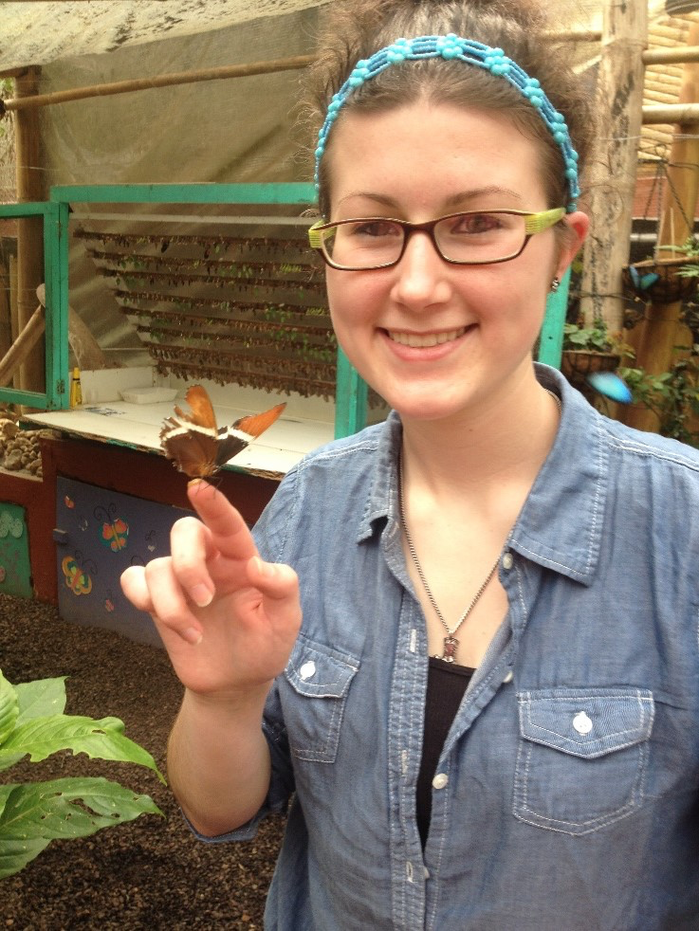
Experiential Learning
Lead activities
Weekly training with collaborative brainstorming
Prompted individual reflection on self and others
Whole-group debriefing: what worked well, what didn’t, how can we do better?
Ongoing and diverse opportunities for facilitating dialogue, managing small group dynamics, teaching, leadership inside and outside the classroom

Slide 19
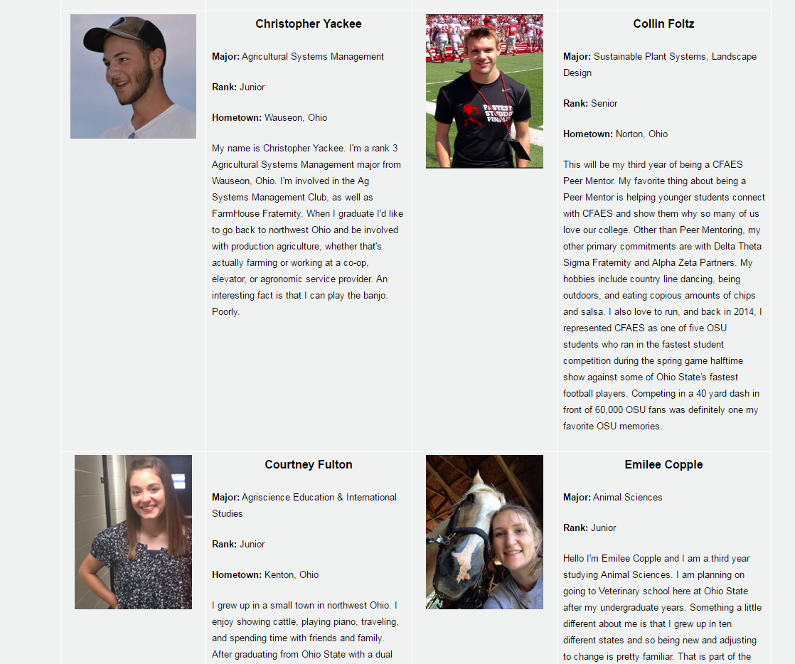
Meet our Peer Mentors
Webpage
Peer Mentors are asked to create a biography.
Practice writing a personal biography
Used to introduce PM’s to their students
Documents their service as a PM

Slide 20
Leadership
Leadership, Personality, etc.
StrengthsQuest, VIA Strengths, MBTI
Career
Resume and interviewing
Cultural diversity
Intercultural mentoring
Educational growth
Recognizing and reflecting on stages of cognitive development
Psychosocial
Identifying students in distress

Slide 21
Lindsay McGory
Academic Counselor
Fisher College of Business
#FYConference

Slide 22
Fisher Peer Advisor Program
History and Mission
Started in 2004
Mission: Provide knowledge and resources to foster academic and professional success. Peers serve as role models and mentors for academic, co-curricular and leadership involvement.

Slide 23
Fisher Peer Advisor Program
Role of Peer Advisors
Co-instruct class (BA 1100 (NFYS and Transfer), BA 1101 (campus change) and BA 1200 (major change)
Hold office hours
Introduce students to resources and enrichment opportunities
Assist students in transition to college life
Plan and host events
Increase mentee’s sense of belonging

Slide 24
Fisher Peer Advisor Program
Who are the Peers?
Currently 16 peer advisors serving over 1800 students
Rank 3 or 4 with campus or Fisher involvement
3.2 GPA or higher
Paid by the hour
10 hours/week in autumn
3-7 hours/week in spring

Slide 25
Jill Auxter
Academic Advisor and
First Year Experience Coordinator
College of Nursing
#FYConference

Slide 26
Leadership and Mentoring Program (LAMP)
in the
College of Nursing

Slide 27
LAMP Program -
Background
Need for mentoring program within pre-nursing major
Guidance in to a professional program
Connection to the college

Slide 28
LAMP Program -
Structure
Assignment of LAMP leaders
Pre-Nursing students in Survey
Structured and informal interactions
Structure of LAMP class

Slide 29
LAMP Program -
Outcomes and Results
Positives
Connection to college
Guidance from current student
Character builders
First year: trial and error
How “invested” a student was in having a mentor

Slide 30
LAMP Program -
Opportunities for Growth
Suggestions from LAMP Leaders
Kick-off event
Matching system
Opt-in or opt-out option
Integrated assignments

Slide 31
Barbara Fink
Professor
College of Optometry
Ohio LSAMP Alliance
#FYConference

Slide 32
LSAMP Programming at The Ohio LSAMP Alliance
Advisement and Counseling
Bridge/Early Arrival Programs
Tutoring or Supplemental Instruction
Peer Mentoring
Faculty Mentoring
Undergraduate Research
Professional Development Workshops

Slide 33
LSAMP Peer Mentor Program at OSU
Job Description:
Junior or Senior LSAMP Scholars
Minimum GPA: 2.8
Matched with freshmen, community college, or transfer students
Participate in activities to transition students socially and academically into OSU and STEM major
Pay: $10.00/hour for 5-10 hours/week

Slide 34
LSAMP Peer Mentor Program at OSU
Application
Consider the challenges or barriers to success a student might face in transferring to a new university. Please identify 2 specific challenges and how you, as a peer mentor, would empower a new student to overcome them.
Please discuss why you have selected your major and your future career goals.

Slide 35
LSAMP Peer Mentor Program at OSU
Application (continued)
Please attach a résumé or CV in .pdf format
Please attach one letter of recommendation from your institution’s principal investigator.
Please attach a 500-word letter of interest detailing the skills you currently possess that make you successful in this position and what you hope to gain form being a peer mentor.

Slide 36
LSAMP Peer Mentor Program at OSU
Goals of Peer Mentoring Program:
Engage mentees in academic and social community
Help mentees utilize the tools and resources of the university to help them achieve academic success
Strengthen relationships between mentees and faculty and staff
Help mentees develop an interest in conducting undergraduate research and engage in their STEM discipline

Slide 37
LSAMP Peer Mentor Program at OSU
Training of Peer Mentors:
Peer Mentoring in STEM: Training for Mentors
Title IX Preventing Sexual Misconduct
Institution Data Policy
FERPA (Family Educational Rights and Privacy Act)

Slide 38
LSAMP Peer Mentor Training MOOC
Home Page:
Description of “Peer Mentoring in STEM: Training for Mentors”
Course Welcome (video)
What Is LSAMP? (video)

Slide 39
LSAMP Peer Mentor Course Description
Three main areas of training:
Building and managing effective peer relationships
Understanding the transitioning student
Cultural competency in STEM professions

Slide 40
LSAMP Peer Mentor Training MOOC
Modules
Module 1: Introduction Peer Mentoring
Module 2: Building the Relationship with your Mentee
Module 3: Introduction to Student Development Theory

Slide 41
LSAMP Peer Mentor Training MOOC
Modules (continued)
Module 4: Working with Community College and Transfer Students
Module 5: Supporting Academic and Social Transition to College
Module 6: Cultural Competence

Slide 42
LSAMP Peer Mentor Components of Each Module
Module Overview
Introductory Video
Module Objectives
Module Content
What to View and Read
Narrated Power Point Presentation and PDF
Videos
Reading assignments

Slide 43
LSAMP Peer Mentor Components of Each Module
What to Work On
Surveys/Inventories
Writing Assignments (reflections)
Quizzes
Things to Discuss
Reflections on questions
Additional Resources
References
Links

Slide 44
LSAMP Peer Mentor
Additional Components of MOOC
Welcome Survey
User Experience Survey (after Module 4)
Final Project
Peer Mentor Training Post-Assessment

Slide 45
LSAMP Peer Mentor
Training MOOC
https://www.canvas.net/browse/stem/osu-stem/courses/peer-mentoring-in-stem

Slide 46
Amy Collins-Warfield
Academic Advisor and
Coordinator of First-Year Programs
College of Education and Human Ecology
Karleton Munn
Peer Mentor Coordinator
College of Education and Human Ecology
#FYConference

Slide 47
EHE Peer Mentor Program
Mission Statement
The mission of the EHE Peer Mentor program is to foster community by supporting EHE undergraduates as they navigate college life at The Ohio State University. As leaders in the college, peer mentors play an integral role in the EHE 1100 survey course through partnerships and collaborations with academic advisors.

Slide 48
EHE Peer Mentor Program
Program Goals
Assist first-year student transition to college life at Ohio State
Connect undergraduates to the Office of Undergraduate Student Services
Provide leadership opportunities to EHE undergraduates

Slide 49
EHE Peer Mentor Program
2015-2016
Pilot year: 4 peer mentors in 2 Survey courses (EHE 1100)
Peer mentors earned academic credit (EHE 5193, 1 cr. toward elective credit)

Slide 50
EHE Peer Mentor Program
2016-2017
First year: 23 peer mentors, 10 Survey courses (EHE 1100)
Peer mentors earned academic credit (ESHESA 2570, 3 cr. toward leadership minor)

Slide 51
EHE Peer Mentor Program
2017-2018
Applications due March 1!

Slide 52
Jenny Osborn
Associate Director
First Year Experience
#FYConference

Slide 53
FYE Peer Leaders
Purpose
Outreach
Facilitating Orientation small groups, pre-enrollment programs, FYSS peer resource sessions, and BBC discussions
Intentionally advocating for and supporting students who are traditionally less likely to persist at the university

Slide 54
FYE Peer Leaders
Purpose
Relationship development
Leading one-on-one and small group success coaching from a peer perspective
Referrals to campus partners in student success (e.g. faculty, housing staff, academic advisors)
Providing ongoing intervention and follow-up with students who are having a difficult transition to Ohio State

Slide 55
FYE Peer Leaders
Data-informed practice
Stoplight - rapid assessment at orientation (social
Ruffalo Noel-Levitz College Student Inventory (CSI) results with indications including study habits, academic confidence and receptivity to support services.
Tracking interactions through Talisma (our CRM tool)

Slide 56
FYE Peer Leaders
Practicalities
Since initial contact is made at orientation, focus is on Autumn domestic freshmen
Roughly 1:250 ratio this year
PLs work full-time May-July and roughly 8-12 hours a week during the academic year
Weekly staff meeting and weekly 1:1 meetings with their staff supervisor
Conditions of Appointment (COA)

Slide 57
Peer Panel
Yasmin Abdulhadi, Fisher Peer Mentor
Brian Clark, EHE Peer Mentor
Sarah Long, LAMP Leader
Rachel McClellan, CFAES Peer Mentor
Tennea Taylor-Jenkins, FYE Peer Leader
#FYConference

